Slide 1
Workshop 8
Saffian Asghar
Emilio Espinosa Sanchez

Slide 2
WORKFLOW
Introduction
Basic concepts
Dataset 1: Diabetes
Analyze the data, model construction and comparison
Dataset 2: MNIST
Analyze the data, model construction and comparison

Slide 3
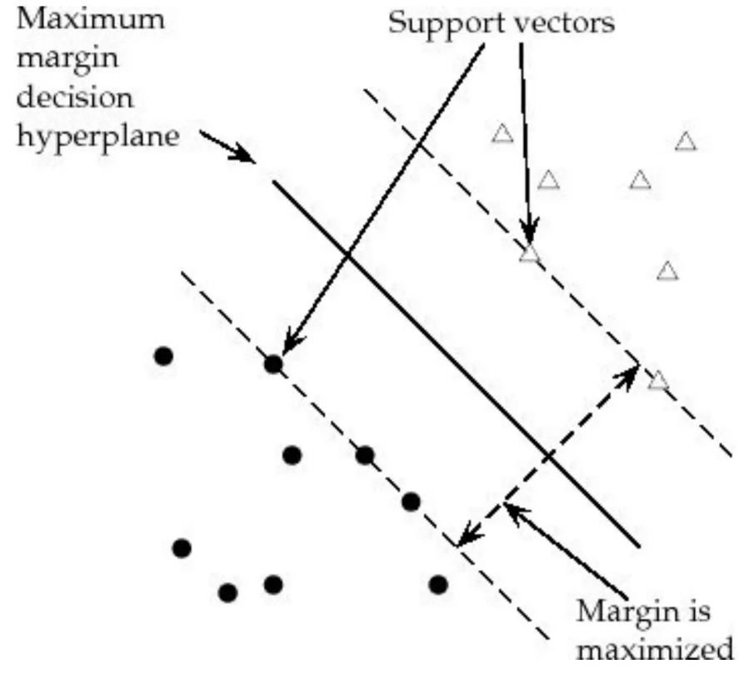
Support Vector Machine
Description
A Support Vector Machine (SVM) is a discriminative classifier that outputs and optimal hyperplane to categorize new example data
Tuning Parameters
Kernel
C (Regularization)
Gamma

Slide 4
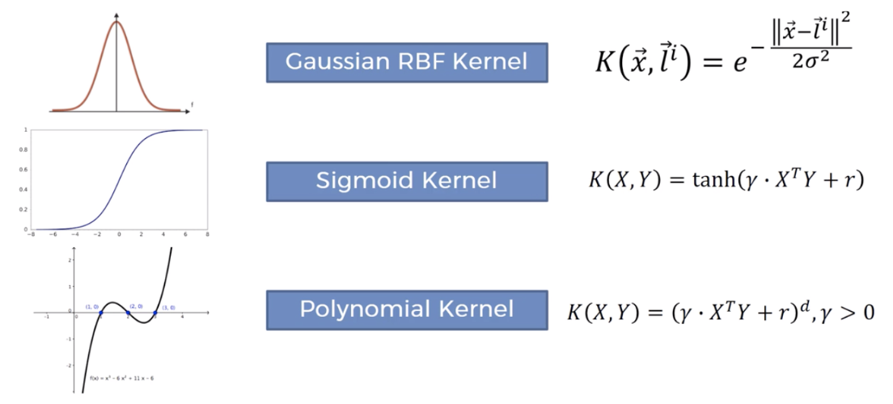
Choice of Kernel
Description
The main function of the kernel is to take low dimensional input space and transform it into a higher-dimensional space.
It is mostly useful in non-linear separation problem

Slide 5
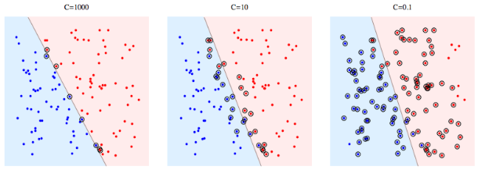
Effect of C(Regularisation)
Description
C is the penalty parameter, which represents misclassification or error term.
The misclassification or error term tells the SVM optimisation how much error is bearable.
This is how you can control the trade-off between decision boundary and misclassification term.
When C is high it will classify all the data points correctly, also there is a chance to overfit

Slide 6
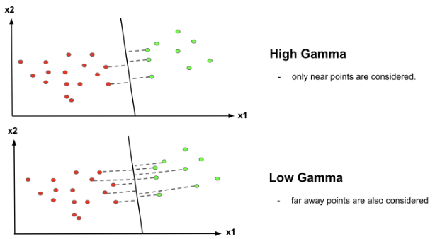
Gamma
How far influences the calculation of plausible line of separation
When gamma is higher, nearby points will have high influence; low gamma means far away points also be considered to get the decision boundary

Slide 7
Pima Indians Diabetes

Slide 8
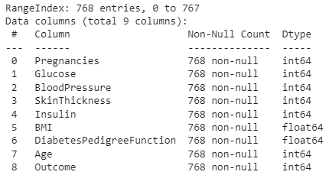
EDA
Predict onset of diabetes based on diagnostic measures
Interesting: no missing values

Slide 9
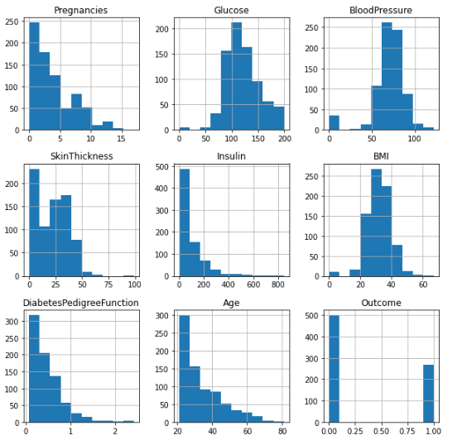
EDA - Distributions
Predict onset of diabetes based on diagnostic measures

Slide 10
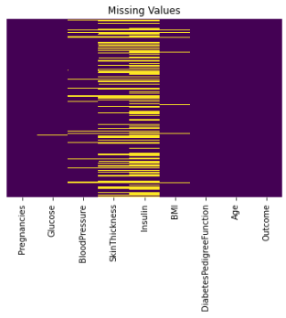
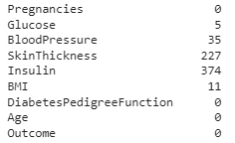
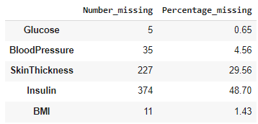
EDA
Replace 0’s in Glucose, BloodPressure, SkinThickness, Insulin, BMI columns with NaN

Slide 11
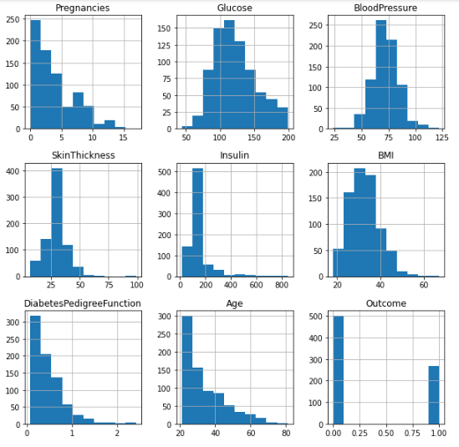
EDA
Glucose and BloodPressure with mean.
SkinThickness, Insulin and BMI with median.

Slide 12
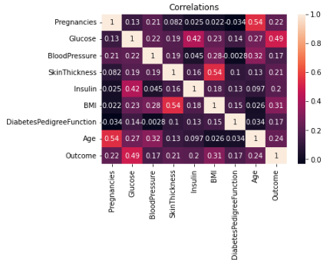
EDA

Slide 13
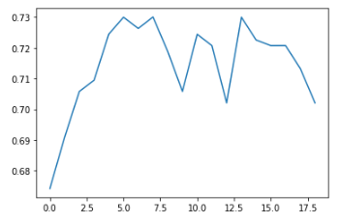
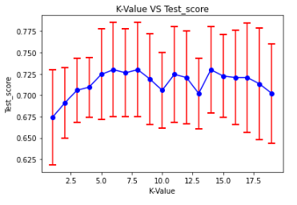
KNN
Find best K.
CV = 5
Notes:
# Accuracy: how good we were in recognizing positive and negative
# Precision: how correct the classifier is
# Recall: how complete the classifier is
# F-Score: combination of presition and recall

Slide 14
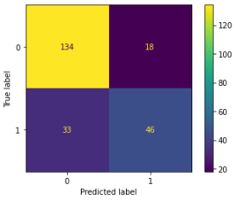
KNN
Find best K.
CV = 5
Metric | Value
Accuracy | 0.779
Precision | 0.719
Recall | 0.582
Notes:
# Accuracy: how good we were in recognizing positive and negative
# Precision: how correct the classifier is
# Recall: how complete the classifier is
# F-Score: combination of presition and recall

Slide 15
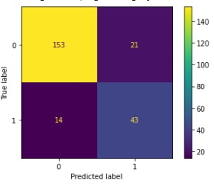
Random Forest
No. of estimators: 200
Feature: sqrt
Max depth: 4
Criterion: Gini
CV: 5
Metric | Value
Accuracy | 0.784
Precision | 0.754
Recall | 0.544
Notes:
# Accuracy: how good we were in recognizing positive and negative
# Precision: how correct the classifier is
# Recall: how complete the classifier is
# F-Score: combination of presition and recall

Slide 16
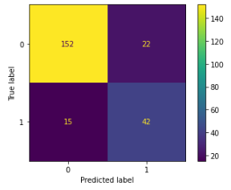
SVM
C: 10
Gamma: 0.0001
Kernel: rbf
CV: 5
Metric | Value
Accuracy | 0.766
Precision | 0.719
Recall | 0.519
Notes:
# Accuracy: how good we were in recognizing positive and negative
# Precision: how correct the classifier is
# Recall: how complete the classifier is
# F-Score: combination of presition and recall

Slide 17
MNIST Dataset

Slide 18
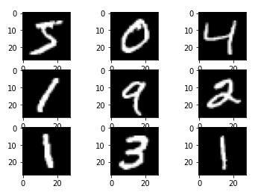
Description
Set is a large collection of handwritten digits
MNIST is short for Modified National Institute of Standards and Technology database
Contains a collection of 70,000, 28 x 28 images of handwritten digits from 0 to 9.

Slide 19
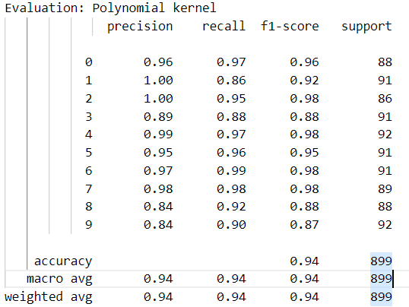
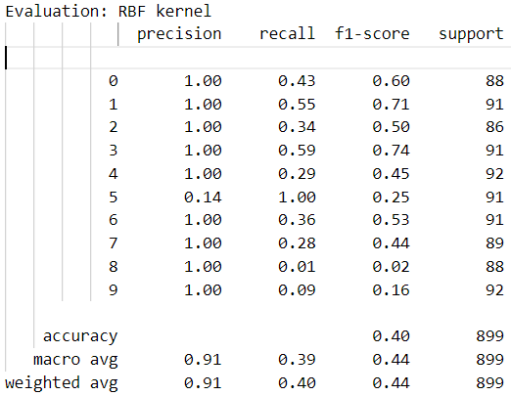
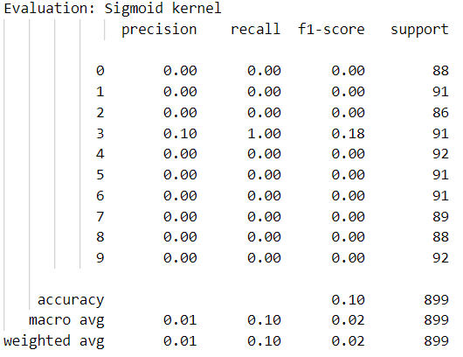
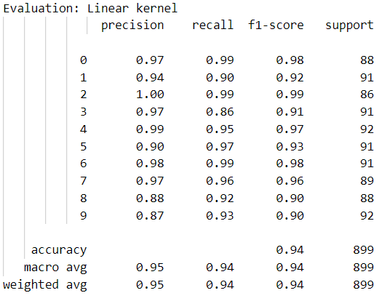
SVM Kernel Selection

Slide 20
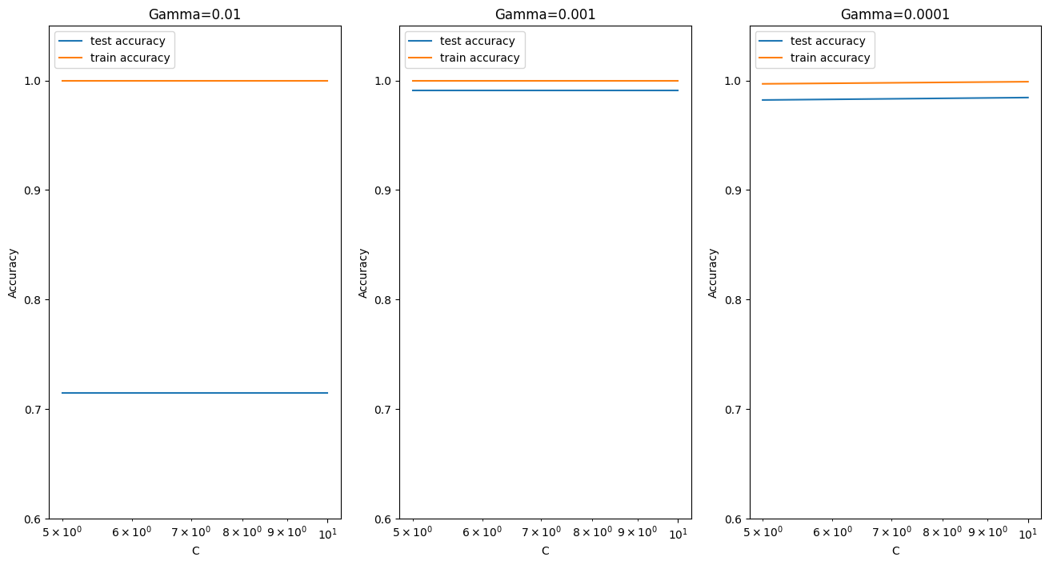
SVM Effect of Gamma

Slide 21
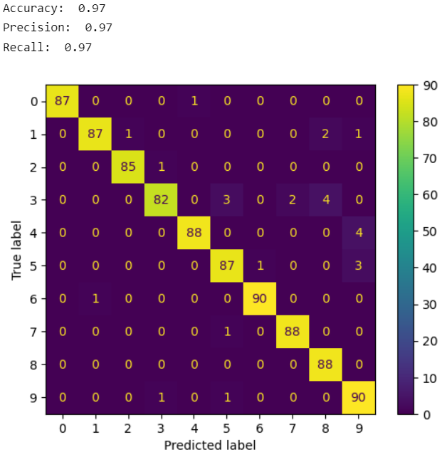
Best model for SVM
The best test score is 0.991 corresponding to hyperparameters
C: 5, gamma: 0.001
With kernel being RBF

Slide 22
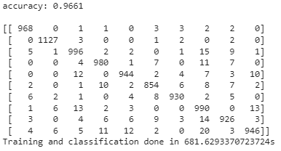
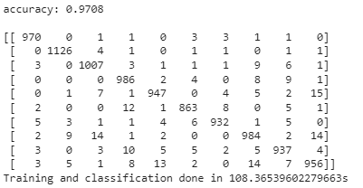
PCA

Slide 23
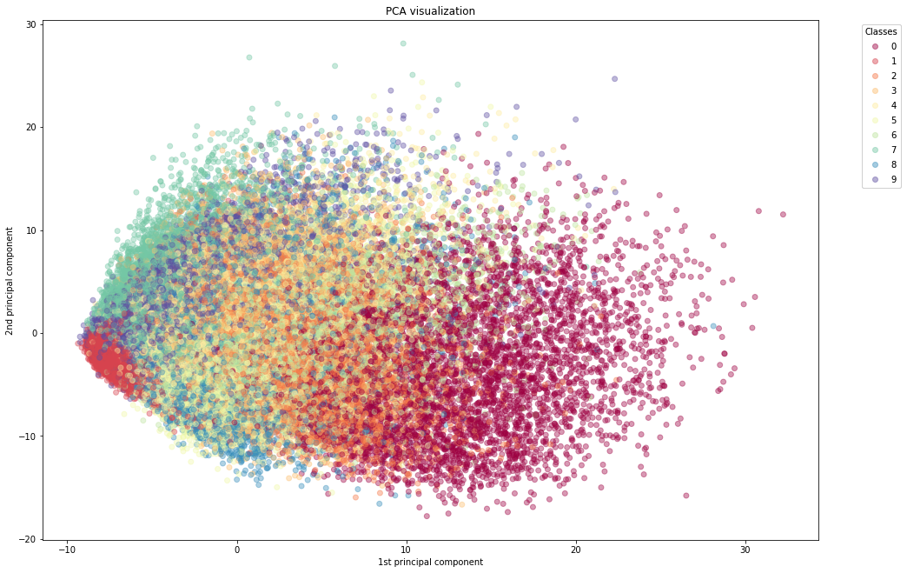
PCA

Slide 24
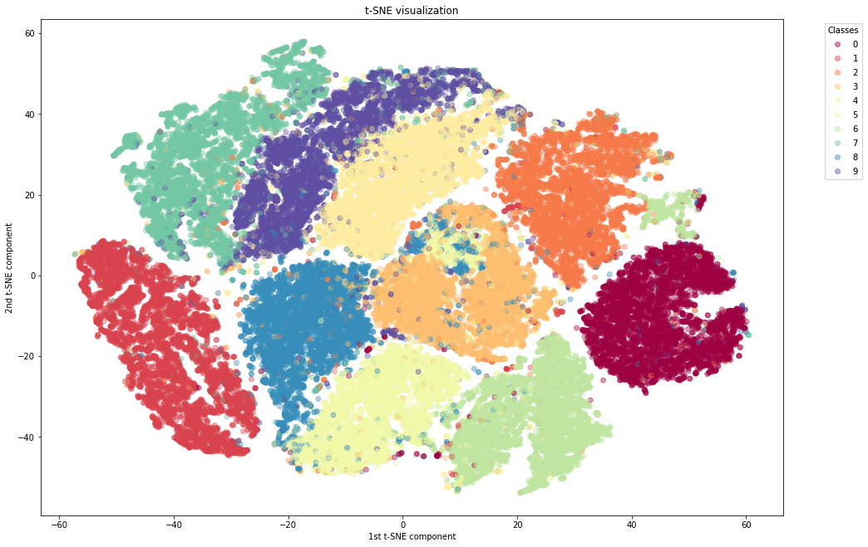
t-SNE
50 components
19 min.

Slide 25
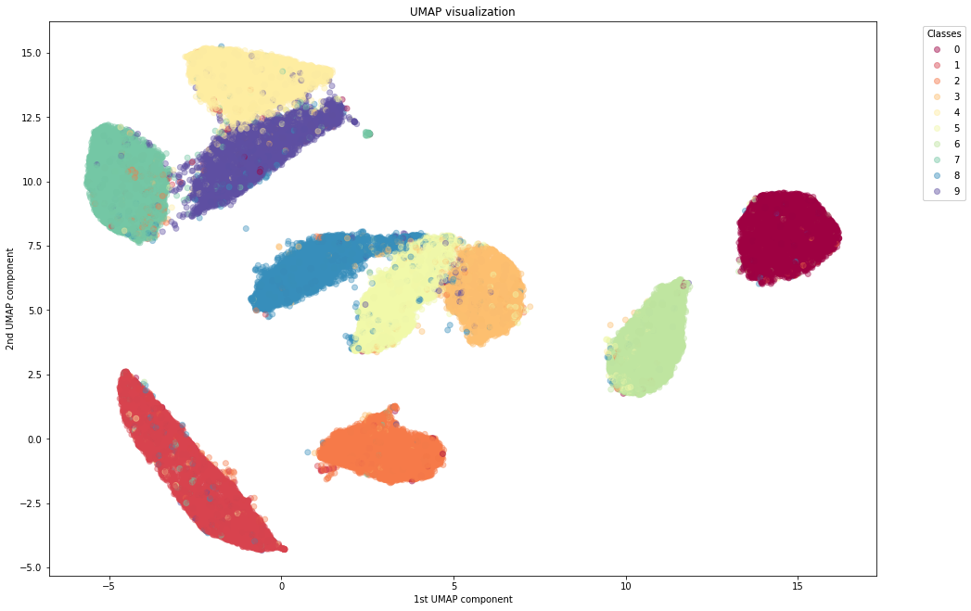
UMAP
2 min.

Slide 26
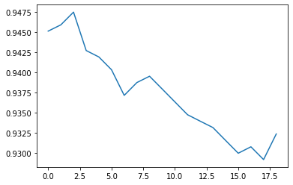
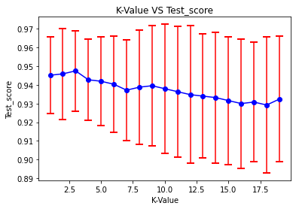
KNN
Find best K.
CV = 5
Notes:
# Accuracy: how good we were in recognizing positive and negative
# Precision: how correct the classifier is
# Recall: how complete the classifier is
# F-Score: combination of presition and recall

Slide 27
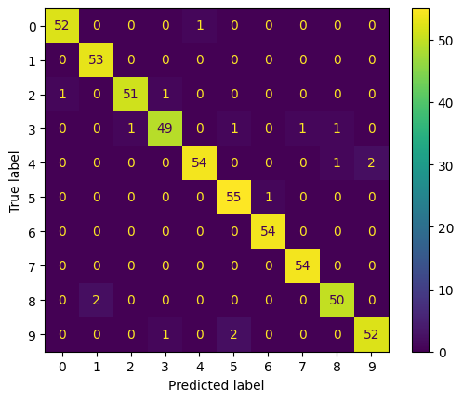
KNN
Find best K.
CV = 5
Metric | Value
Accuracy | 0.97
Precision | 0.97
Recall | 0.97
Notes:
# Accuracy: how good we were in recognizing positive and negative
# Precision: how correct the classifier is
# Recall: how complete the classifier is
# F-Score: combination of presition and recall

Slide 28
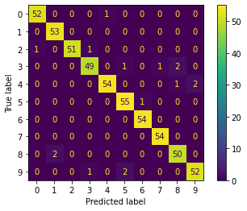
Random Forest Classifier
Best Params: {'criterion': 'entropy', 'max_depth': 8, 'max_features': 'auto', 'n_estimators': 500}
Metric | Value
Accuracy | 0.917
Precision | 0.917
Recall | 0.917
Notes:
# Accuracy: how good we were in recognizing positive and negative
# Precision: how correct the classifier is
# Recall: how complete the classifier is
# F-Score: combination of presition and recall

Slide 29
THANK YOU
Saffian
Emilio

